Slide 1




Encryption and decryption for secure payment application using AES algorithm and secret key delivery and signature with EC El-Gamal
Submitted by
Bradley Feitsvaig 311183073
David Nashash 321522302
Aviv Okun 312426570
Submitted to
Prof. Zeev Volkovich
Dr.Renata Avros.

Slide 2




Introduction
Secure payment application
4 main requirements:
Data confidentially
Data integrity
Authentication
Nonrepudiation
Hybrid encryption model.

Slide 3
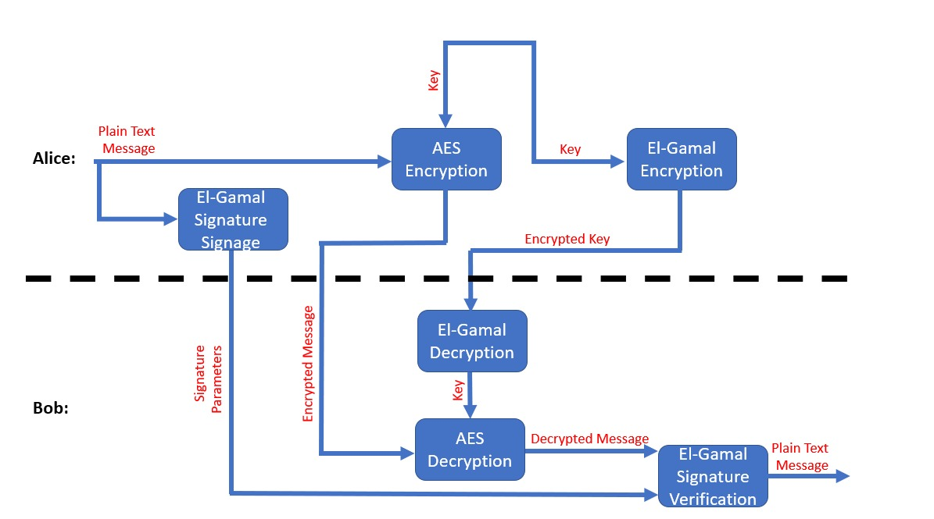
Introduction
AES: Encryption and decryption of the payment method.
EC El-Gamal:
Encryption and decryption of AES Key.
Signature/ Signature verification on the plain text.

Slide 4
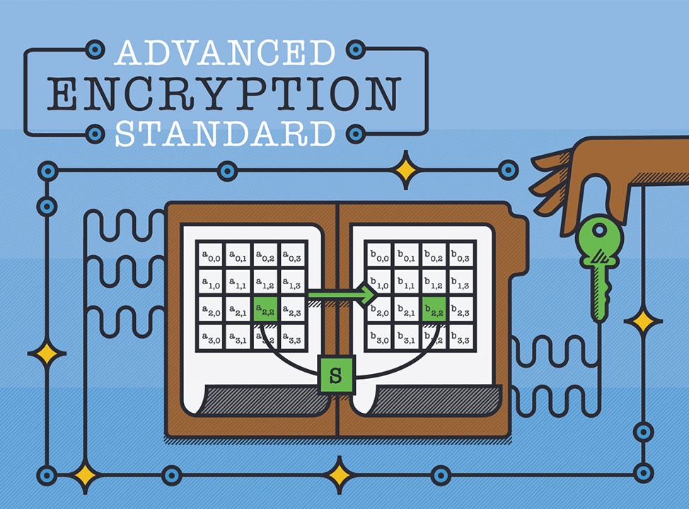
AES - Advanced Encryption Standard
Symmetric block cypher algorithm.
Key and block size of 128 bits.
10 rounds.
Fast.
Adopted by the U.S government in 2002.
Superseded DES.
In 2003, U.S government announced that it’s secure enough to protect classified information.

Slide 5
AES - Advanced Encryption Standard
Byte hex value is broken into an upper and lower nibble.
Series of transformations beginning with an initial round and finishing with a final round.

Slide 6
AES - Advanced Encryption Standard
In the middle, a round of 4 transformation is applied repeatedly.
For 128 bit key, 10 rounds are used.
Longer keys, requires more rounds.
Different sub-key is used for each round.
Sub-keys are derived from the main key.

Slide 7
AES – Bytes Substitution
Each byte in the state block is substituted with a byte in S-box.
S-box values are swapped in correspondence to the lower and upper half of the state block byte.

Slide 8
AES – Shift Rows
Every row in the state block is rotated in correspondence to the row number.

Slide 9
AES – Mix Columns
Every column in the state block is multiplied with a given matrix.
This step provides diffusion in the cypher.

Slide 10
AES – Add Round Key
XOR operation is applied to a pair of column from the state block and a column from the round key.

Slide 11
AES – Output
State block transformations are applied for 10 rounds

Slide 12
AES – Key Schedule
A word from the main key is rotated.
Each byte in the word is substituted with a byte in S-box.
XOR operation is applied to the substituted word, first column of the previous key and a column from the round constant matrix.
The output is a word in round key 1

Slide 13
AES – Key Schedule
For the rest of the columns in round key 1 are calculated with the XOR operation applied to column i-1 and column i-4.

Slide 14
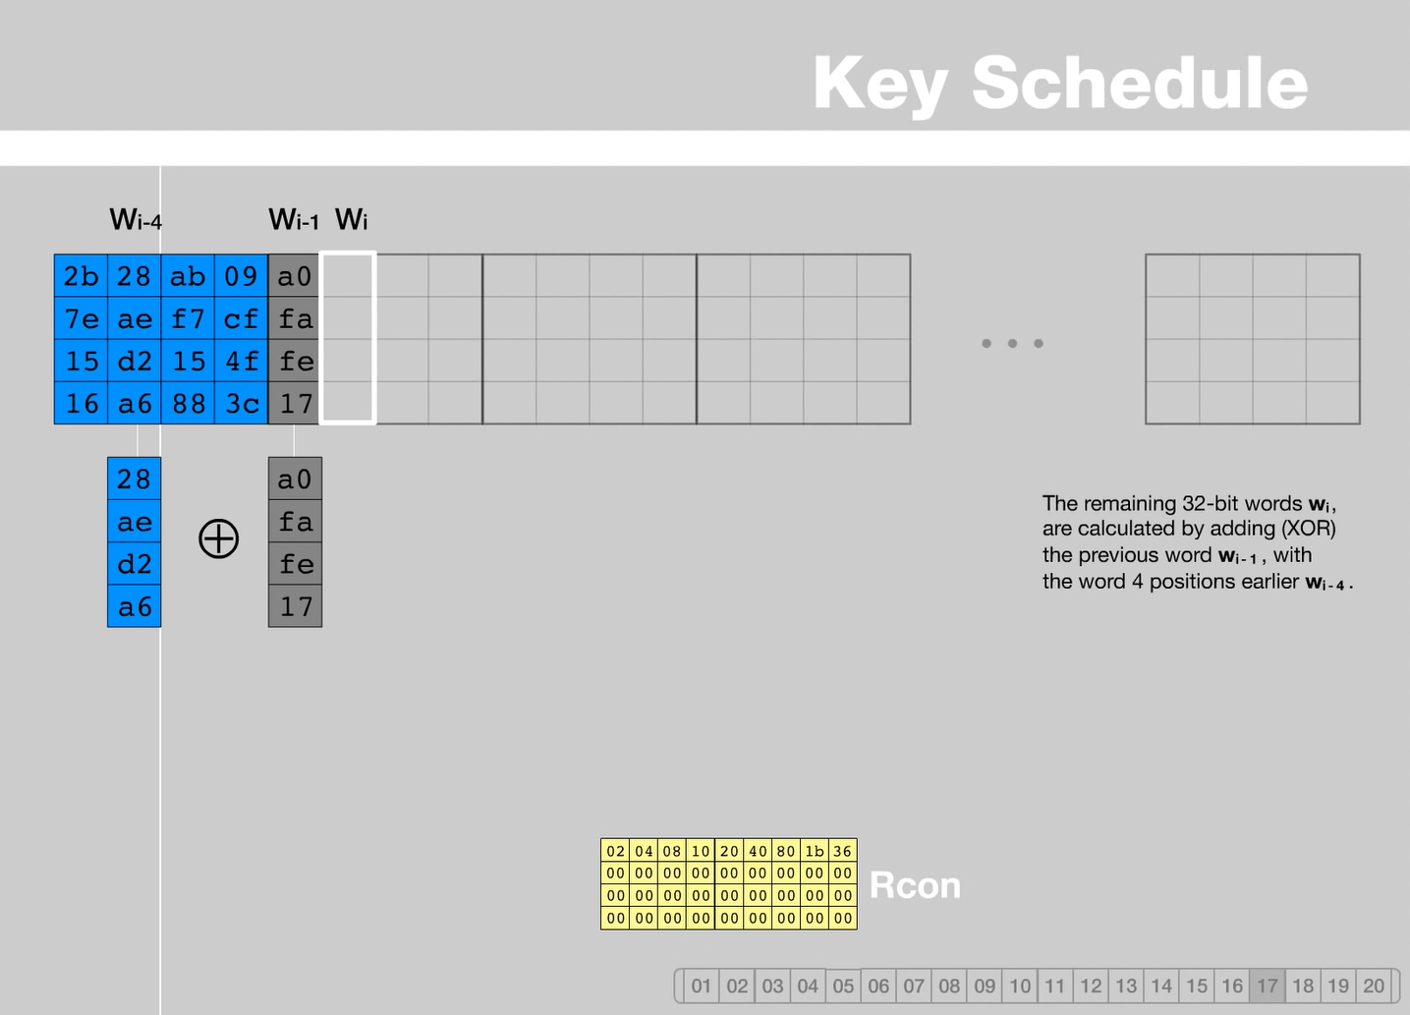
AES – Key Schedule
For the next word column of the next key, a XOR operation is applied between a word column from the previous key and the previous word column.
The rest of the key is filled accordingly.

Slide 15
AES – Key Schedule
The rest of the keys are calculated in the same manner.

Slide 16
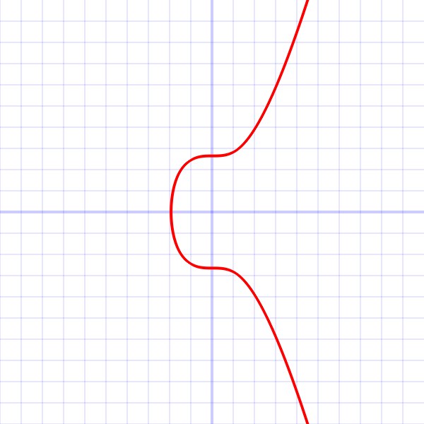
EC EL-Gamal Elliptic curve
Secp256k1 - parameters of the elliptic curve used in Bitcoin
p = 2²⁵⁶ - 2³² - 2⁹ - 2⁸ - 2⁷ - 2⁶ - 2⁴ - 1
A =0
B = 7
y² = x³ + 7 mod p
G = (55066263022277343669578718895168534326250603453777594175500187360389116729240, 32670510020758816978083085130507043184471273380659243275938904335757337482424)
order = 115792089237316195423570985008687907852837564279074904382605163141518161494337

Slide 17


EC EL-Gamal Encryption Decryption
Set up an Elliptic Curve $E$ over a field $F_{q}$ and a generator point $G$ of order $N$
Define a function $f:m→P_{m}$ which maps a message $m$ to a point $P_{m}$ on $E$
Choose a secret key $x∈[1,N−1]$ randomly and publish $Y=xG$ as a public key
Encryption:
Choose random $k∈[1,N−1]$, then calculate $kG$ and $kY$ (kxG)
With $P_{m}=f\left(m\right)$ , the cypher text is the tuple $\left(kG,kY+P_{m}\right)$
Decryption:
From a cypher text $\left(kG,kY+P_{m}\right)$calculate $xkG$, and retrieve the point $P_{m}$ with
$P_{m}=\left(k\left(xG\right)+P_{m}\right)−\left(x\left(kG\right)\right)$
Calculate the message $m$ with $f^{−1}(P_{m})$

Slide 18
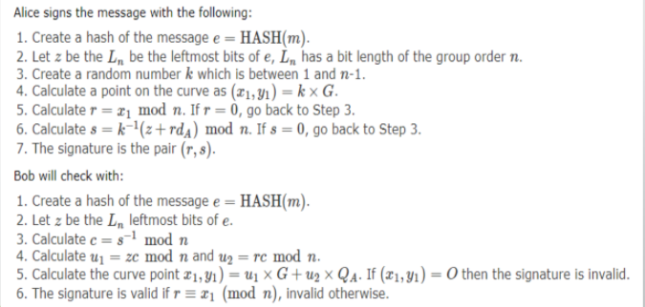

EC EL-Gamal Signature
Using sha256 hash function.
Elliptic curve Secp256k1
Signing only the original message is enough because, in a case where the encrypted key for AES is corrupted, the encrypted message will be decrypted wrong, therefore, the signature verification will fail, and the final message will be considered as invalid.

Slide 19
Conclusion
The hybrid of AES and El-Gamal algorithm takes advantage of both algorithms.
advantage of symmetric cyphers.
Uses fewer computer resources.
Encryption is faster than asymmetric encryption.
Advantage of asymmetric
More secure, no need to share a secret key.
Provides a digital signature.

